Slide 1
STEPS
Section Observation Update
Riser’s meeting | April 17, 2023

Slide 2
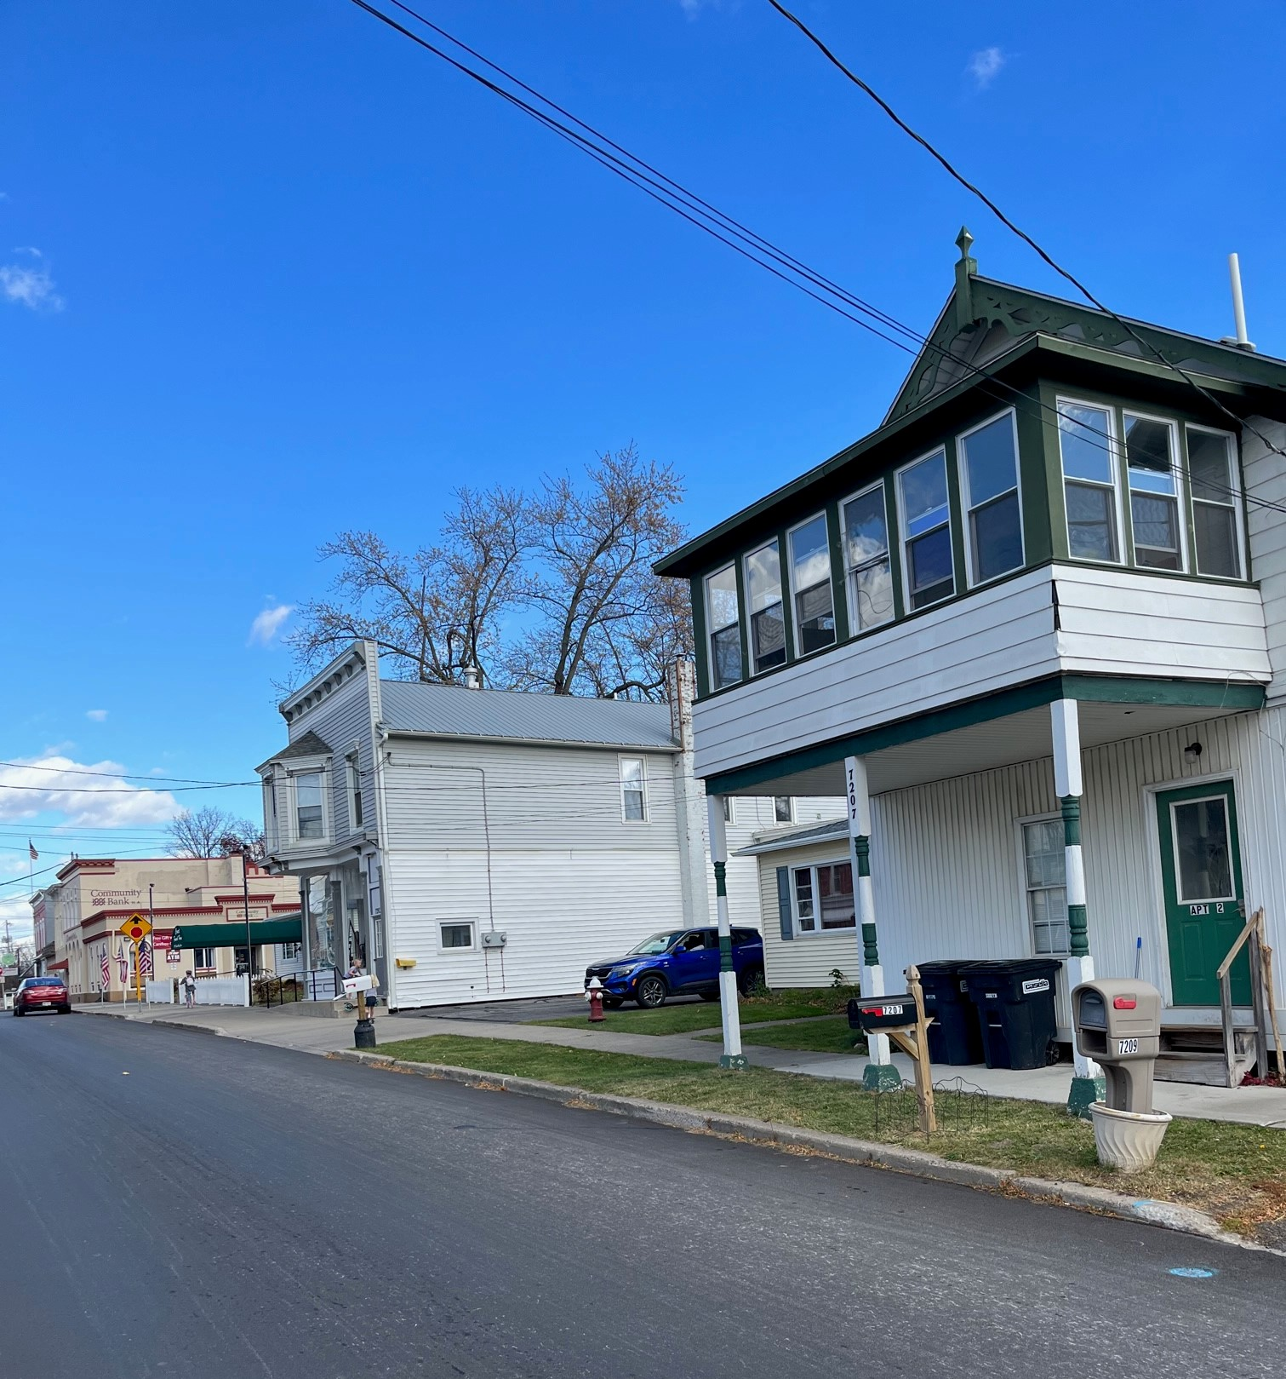
Data Collection Effort
Every two years observations of the village main streets are conducted in Ovid, Lodi, and Interlaken.
4 different years of data - 2016, 2018, 2020, 2022
Systematic approach to observations
Main Street are divided into sections
3 pairs of data collectors rate each section, then average the scores
Data collectors are trained on what and how to rate their observations
Sections and parcels are both observed

Slide 3
What do we look at?
Overall visual appeal
Characteristics of a section
Sidewalks
Street lighting
Well-marked crosswalks
Trash receptacles
Bike racks, etc.
Conditions along the section
Trash along the section
Effect of different elements on the attractiveness of the section
Taken as a whole, looking at all elements of the section (including the structures, open spaces, sidewalks, and street), how visually appealing is the section?

Slide 4
Ovid

Slide 5
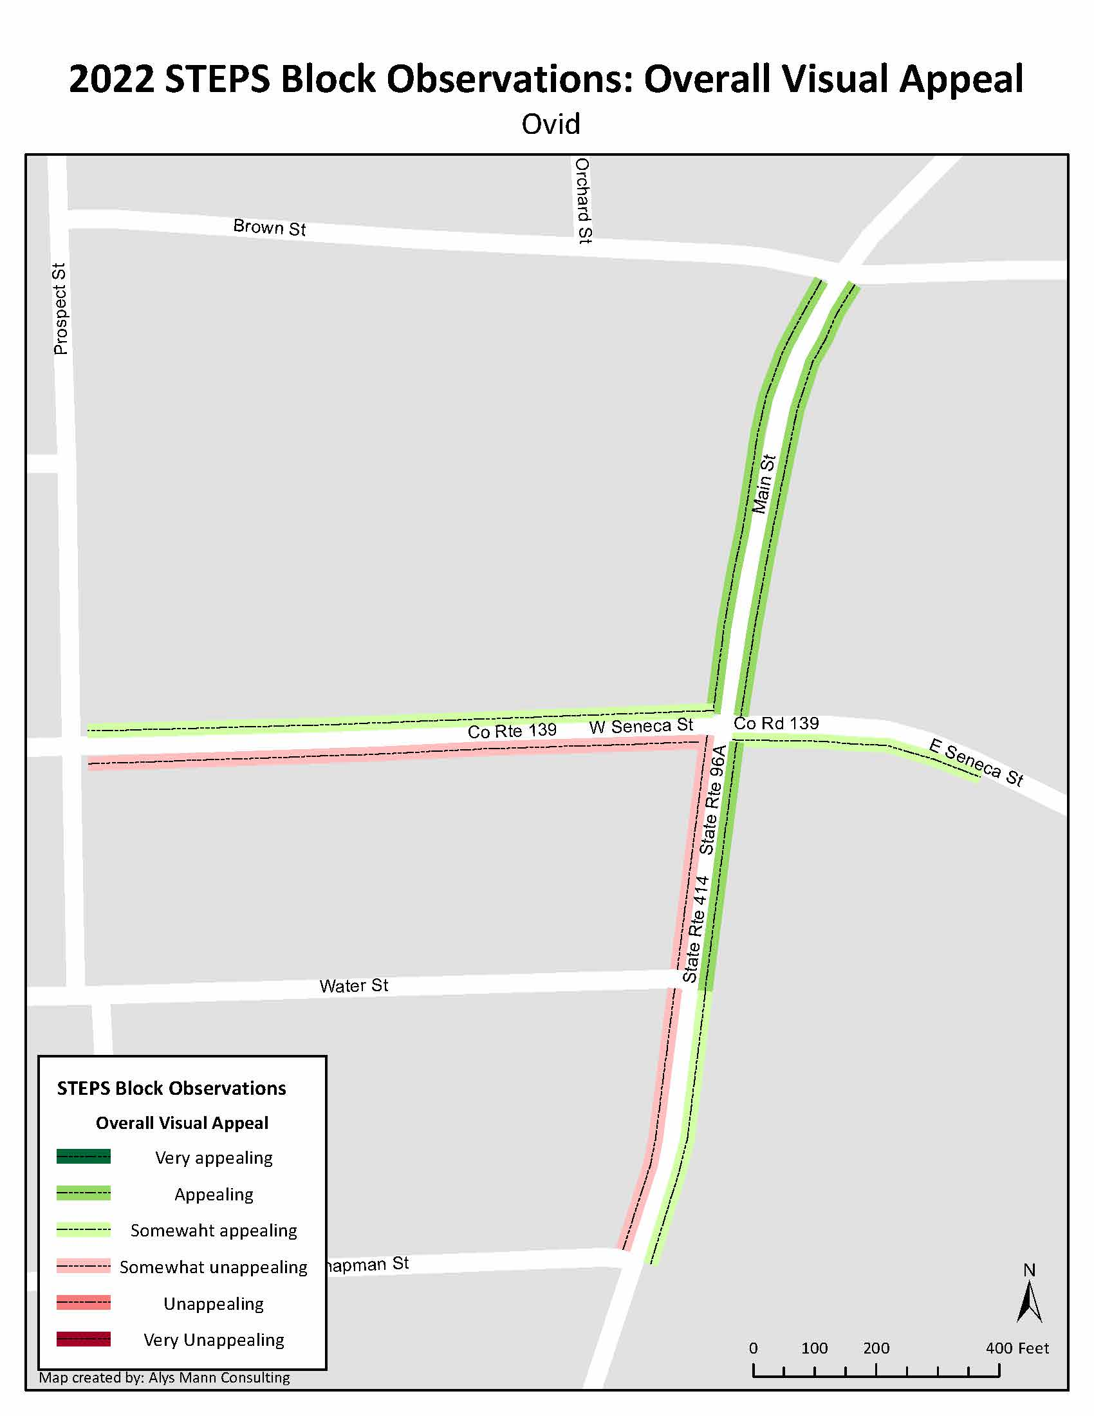
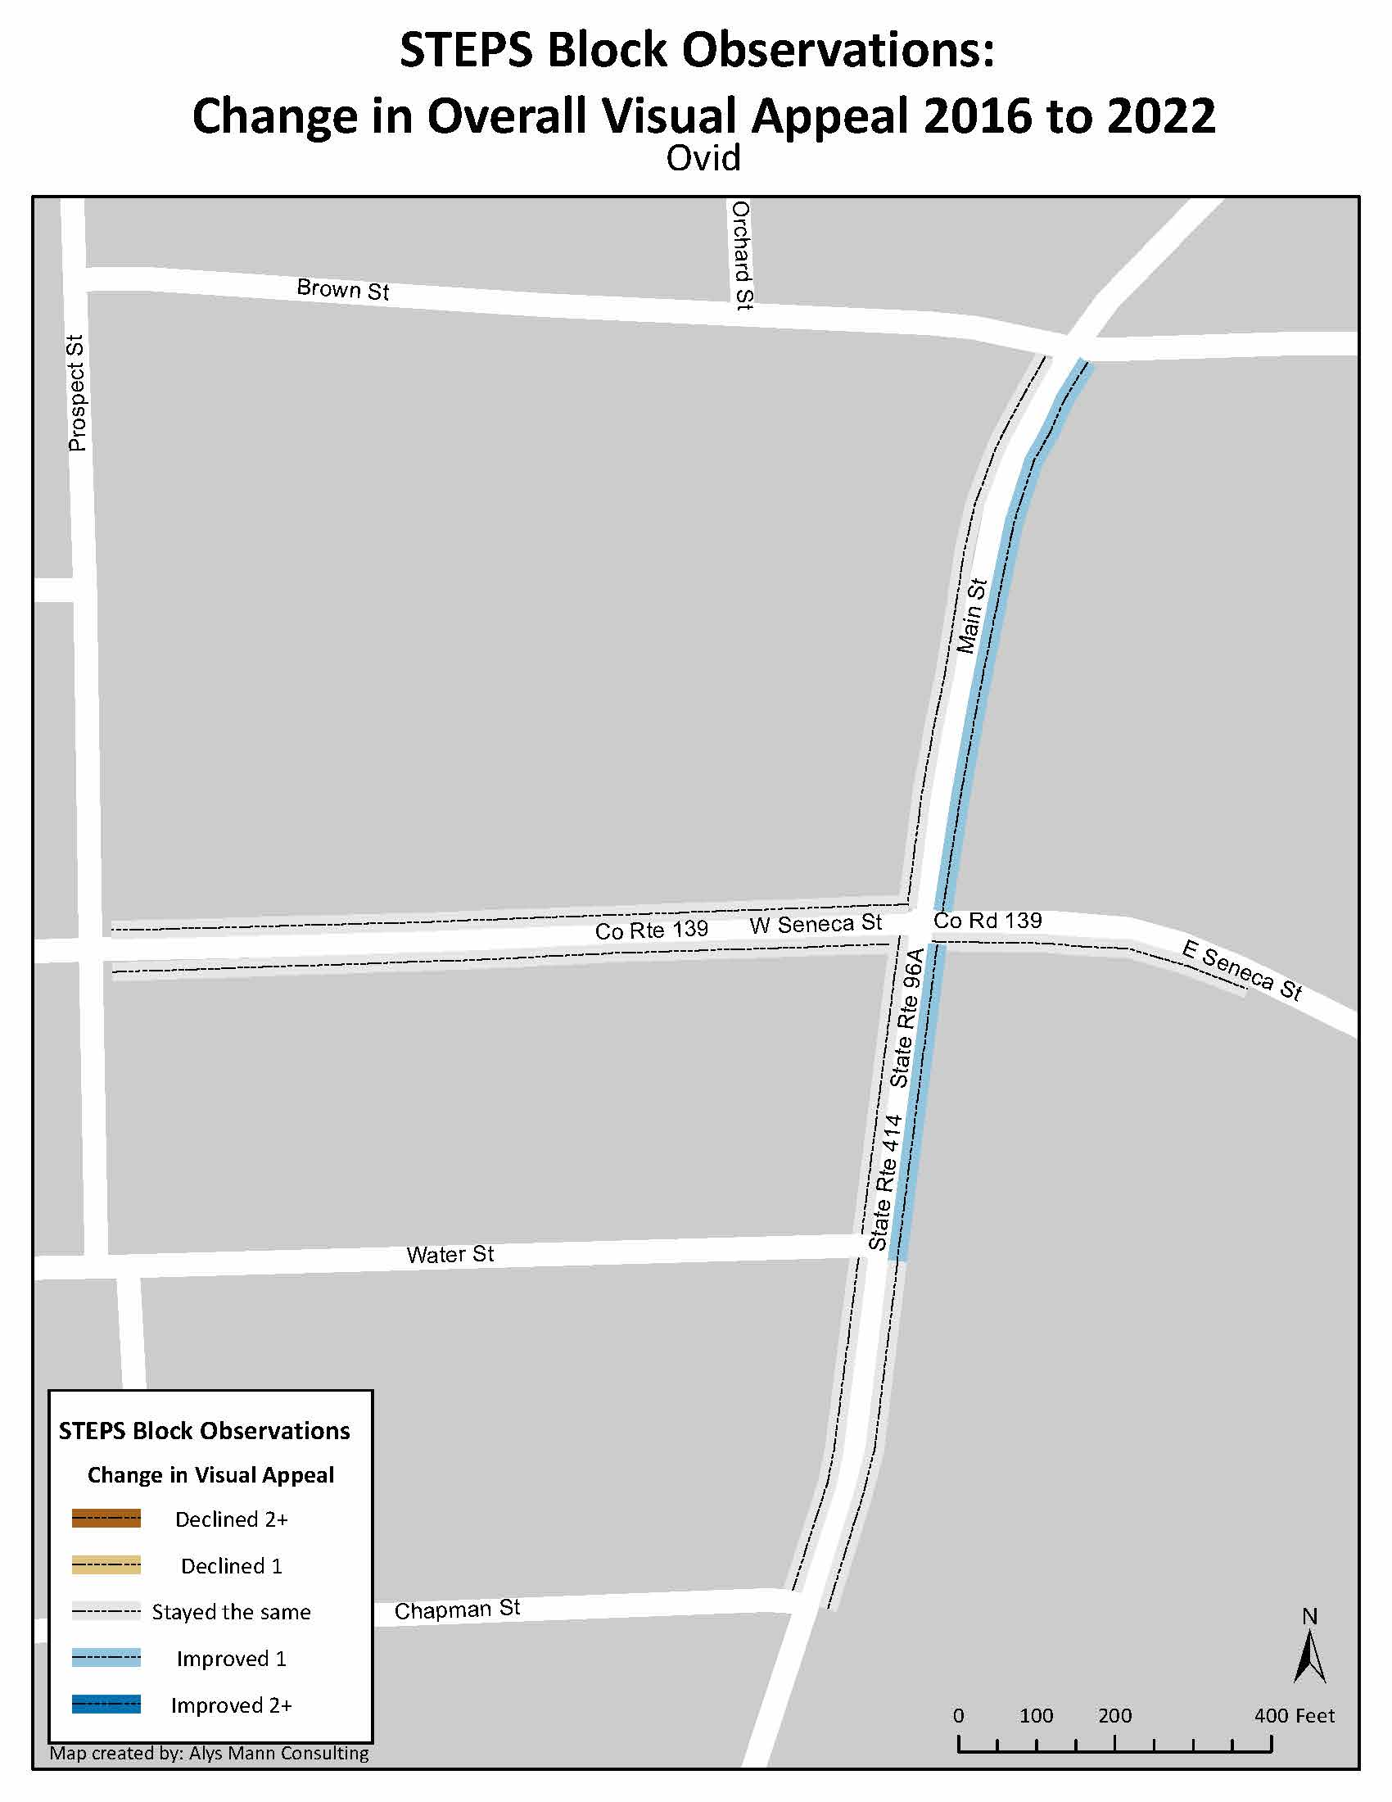

Slide 6
Infrastructure
Along every section observed Ovid has:
Sidewalks
Street lighting
Well-marked crosswalks at appropriate corners
Handicapped access at appropriate corners

Slide 7
Condition of Infrastructure
Decline in number of sections with “well maintained” sidewalks
Characteristic | Year | Well maintained | Adequately maintained | Poorly maintained | Not Applicable
Street Surface (center to curb) | 2016 | 9 | 0 | 0 | 0
 | 2022 | 8 | 1 | 0 | 0
Sidewalk Surface | 2016 | 3 | 4 | 2 | 0
 | 2022 | 1 | 6 | 2 | 0
Curbs | 2016 | 4 | 2 | 0 | 3
 | 2022 | 3 | 3 | 2 | 1

Slide 8
Trash in the section
In 2022, there were two sections that had “some” trash, debris or litter on the street surface or sidewalk, and seven that reported “little or none”
Eight out of the nine sections did not have a trash receptacle and the one trash receptacle was rated “adequately maintained”
Characteristic | Year | A lot | Some | Little or none
Trash, debris, or litter on street surface and/or sidewalks | 2016 | 0 | 0 | 9
 | 2022 | 0 | 2 | 7
Trash, debris, or litter on parcels and/or lots | 2016 | 0 | 3 | 6
 | 2022 | 0 | 4 | 5
Graffiti on buildings, sidewalks, or road surfaces | 2016 | 0 | 0 | 9
 | 2022 | 0 | 0 | 9

Slide 9
Elements of attractiveness
More sections have trees, plants, and flowers and signs and banners that enhance the visual appeal of the section
Characteristic | Year | Enhances the visual appeal | Little or no effect on visual appeal | Detracts from visual appeal | Not applicable
Trees, plants, and flowers | 2016 | 1 | 4 | 1 | 3
 | 2022 | 2 | 3 | 0 | 4
Signs and banners | 2016 | 0 | 7 | 1 | 1
 | 2022 | 3 | 4 | 0 | 2
Public Art (e.g. murals, sculptures) | 2016 | 0 | 0 | 0 | 9
 | 2022 | 0 | 0 | 0 | 9

Slide 10
Conditions and Attractiveness of Structures throughout Ovid sections
41% of structures throughout downtown Ovid are in good condition and need no maintenance or repair
43% of structures need minor repairs only

Slide 11
Lodi

Slide 13
Infrastructure
Along every section observed Lodi has:
Sidewalks
Street lighting
Well-marked crosswalks at appropriate corners
Handicapped access at appropriate corners
Parking signage along the street

Slide 14
Condition of Infrastructure
Increase in the number of sections with “well maintained” sidewalks & “well maintained” curbs
Characteristic | Year | Well maintained | Adequately maintained | Poorly maintained | Not Applicable
Street Surface (center to curb) | 2016 | 4 | 0 | 0 | 0
 | 2022 | 4 | 0 | 0 | 0
Sidewalk Surface | 2016 | 0 | 3 | 1 | 0
 | 2022 | 1 | 2 | 1 | 0
Curbs | 2016 | 1 | 3 | 0 | 0
 | 2022 | 3 | 1 | 0 | 0

Slide 15
Trash in the section
There is little to no trash, debris, or litter on street surfaces, sidewalks, or parcels in Lodi
In 2022 there is little to no graffiti in Lodi
Characteristic | Year | A lot | Some | Little or none
Trash, debris, or litter on street surface and/or sidewalks | 2016 | 0 | 0 | 4
 | 2022 | 0 | 0 | 4
Trash, debris, or litter on parcels and/or lots | 2016 | 0 | 0 | 4
 | 2022 | 0 | 0 | 4
Graffiti on buildings, sidewalks, or road surfaces | 2016 | 0 | 1 | 3
 | 2022 | 0 | 0 | 4

Slide 16
Elements of attractiveness
In 2022, Lodi has public art that enhances the visual appeal along one section.
Characteristic | Year | Enhances the visual appeal | Little or no effect on visual appeal | Detracts from visual appeal | Not applicable
Trees, plants, and flowers | 2016 | 4 | 0 | 0 | 0
 | 2022 | 4 | 0 | 0 | 0
Signs and banners | 2016 | 2 | 2 | 0 | 0
 | 2022 | 1 | 1 | 0 | 2
Public Art (e.g. murals, sculptures) | 2016 | 0 | 0 | 0 | 4
 | 2022 | 1 | 0 | 0 | 3

Slide 17
Conditions and Attractiveness of Structures throughout Lodi sections
7 out of 19 structures are in good condition, while 7 out of 19 structures require a limited number of major repairs
Most structures either have “some visual appeal” or “little or no visual appeal”

Slide 18
Interlaken

Slide 20
Infrastructure
Along every section observed in Interlaken has:
Sidewalks
Street lighting
Handicapped access at appropriate corners
5 out of 7 sections in Interlaken have:
Parking signage along the street
Well-marked crosswalks at appropriate corners

Slide 21
Condition of Infrastructure
Increase in the number of sections with “adequately maintained” sidewalks
Decline in the number of sections with “adequately maintained” curbs
No sections with well maintained sidewalks or curbs
Characteristic | Year | Well maintained | Adequately maintained | Poorly maintained | Not Applicable
Street Surface (center to curb) | 2016 | 7 | 0 | 0 | 0
 | 2022 | 7 | 0 | 0 | 0
Sidewalk Surface | 2016 | 0 | 5 | 2 | 0
 | 2022 | 0 | 6 | 1 | 0
Curbs | 2016 | 0 | 5 | 2 | 0
 | 2022 | 0 | 4 | 3 | 0

Slide 22
Trash in the section
Most sections have little or no trash, debris, or littler on the streets, sidewalks, parcels or lots
Characteristic | Year | A lot | Some | Little or none
Trash, debris, or litter on street surface and/or sidewalks | 2016 | 0 | 0 | 7
 | 2022 | 0 | 1 | 6
Trash, debris, or litter on parcels and/or lots | 2016 | 0 | 0 | 7
 | 2022 | 0 | 0 | 7
Graffiti on buildings, sidewalks, or road surfaces | 2016 | 0 | 0 | 7
 | 2022 | 0 | 0 | 7

Slide 23
Elements of attractiveness
In 2022, fewer sections had trees, plants and flowers that enhanced the visual appeal
Fewer sections had signs and banners that enhance the visual appeal
Characteristic | Year | Enhances the visual appeal | Little or no effect on visual appeal | Detracts from visual appeal | Not applicable
Trees, plants, and flowers | 2016 | 7 | 0 | 0 | 0
 | 2022 | 3 | 2 | 0 | 2
Signs and banners | 2016 | 5 | 1 | 0 | 1
 | 2022 | 1 | 4 | 0 | 2
Public Art (e.g. murals, sculptures) | 2016 | 0 | 0 | 0 | 7
 | 2022 | 0 | 1 | 0 | 6

Slide 24
Conditions and Attractiveness of Structures throughout Interlaken sections
More than half of structures (55%) throughout downtown Interlaken are in good condition and need no maintenance or repair
An equal number of structures in downtown Interlaken have “lots of visual appeal” or “little or no visual appeal”

Slide 25
Questions
Do you have similar impressions of the conditions in Ovid, Lodi, Interlaken?
Did anything stand out as important or surprising?
Who else could benefit from learning about these findings?

